Slide 1
PHYS4260 Quantum Mechanics II Spring 2025
Symmetries and Conservation laws

Slide 2
Outline
Rotationally invariant systems
Degeneracy
Selection Rules
Time translations & the Heisenberg picture

Slide 3
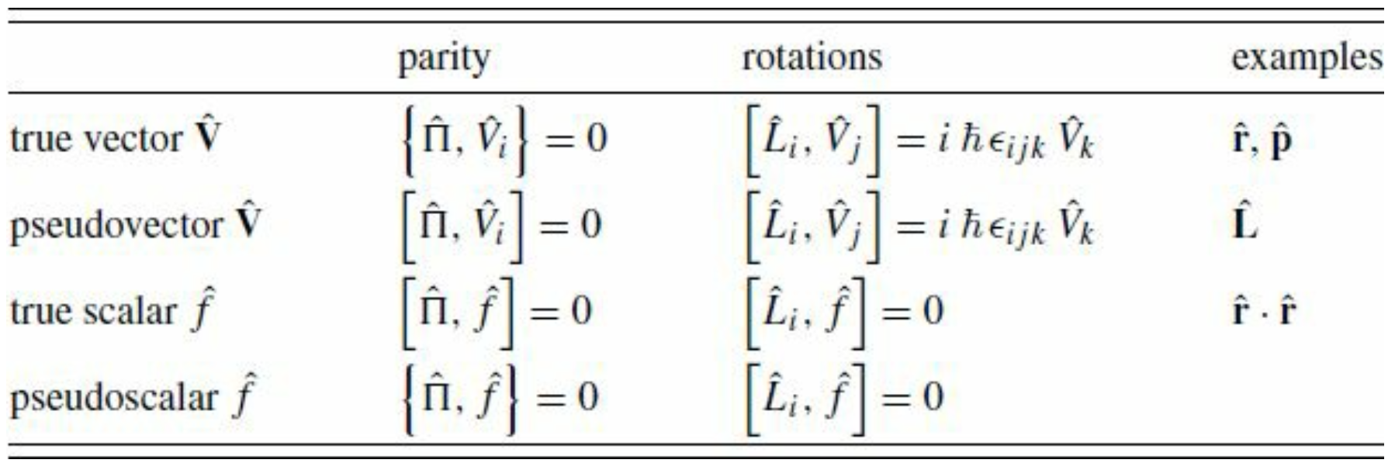
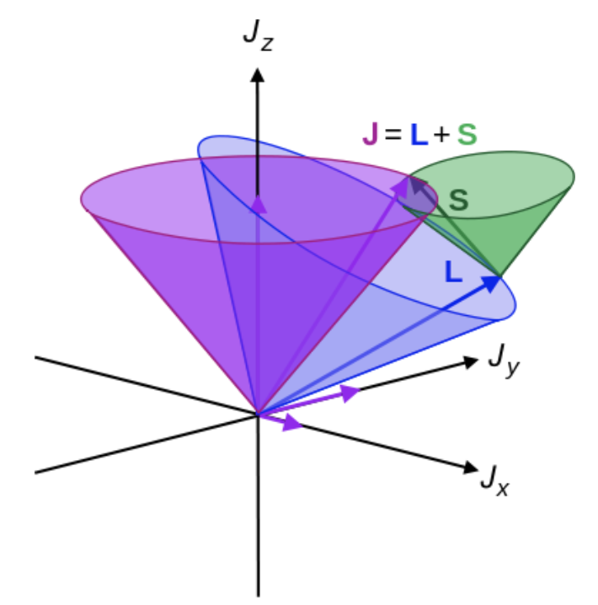
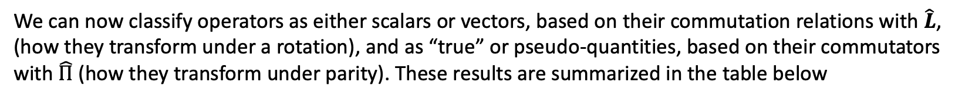
Recap: Operator Classification
We can now classify operators as either scalars or vectors, based on their commutation relations with $\hat{L}$, (how they transform under a rotation), and as “true” or pseudo-quantities, based on their commutators with $\hat{Π}$ (how they transform under parity). These results are summarized in the table below
Note the appearance of anticommutators for pseudo vectors and pseudo scalars!
To include the spin $\hat{S}$ one simply replaces ${\hat{L}}_{i}$everywhere it appears in the third column with ${\hat{J}}_{i}={\hat{L}}_{i}+{\hat{S}}_{i}$.
$\hat{S}$ like $\hat{L}$ is a pseudo vector, while $\hat{p}∙\hat{S}$ is a pseudo scalar.

Slide 4
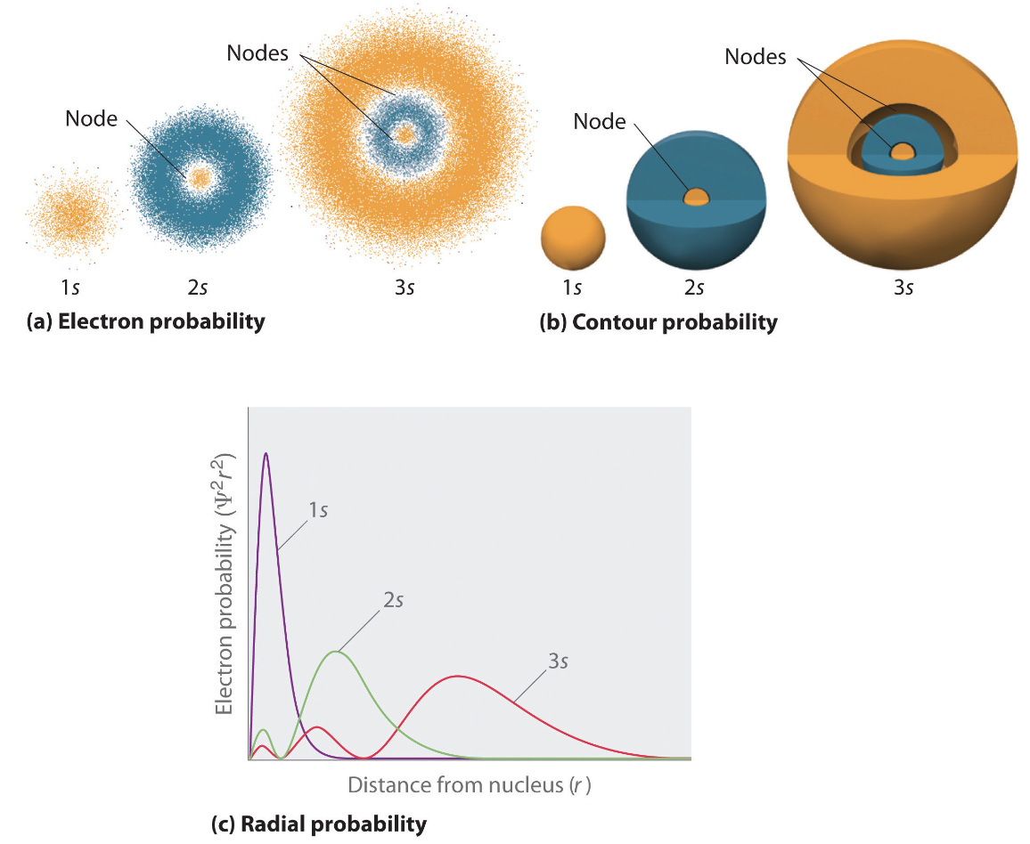
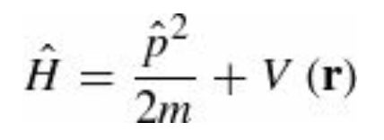
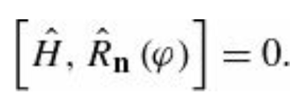
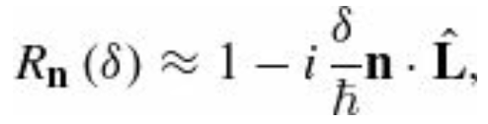
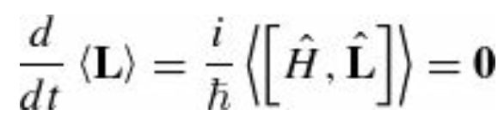
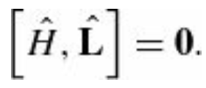
Rotationally invariant systems
For a particle of mass m moving in a potential $V(\hat{r})$ the Hamiltonian
is rotationally invariant if $V\left(\hat{r}\right)=V(r)$ (central potential). In this case, the Hamiltonian commutes with a rotation by any angle about an arbitrary axis
which means that the Hamiltonian commutes with the three components of $\hat{L}$
Using Ehrenfest’s theorem:
for a central potential. Thus, angular momentum conservation
is a consequence of rotational invariance.

Slide 5
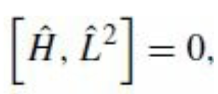
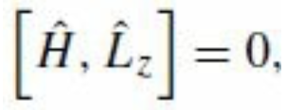
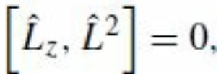
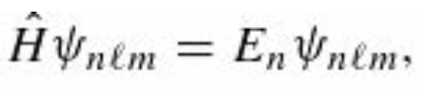
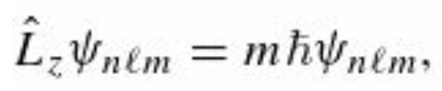
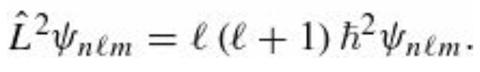
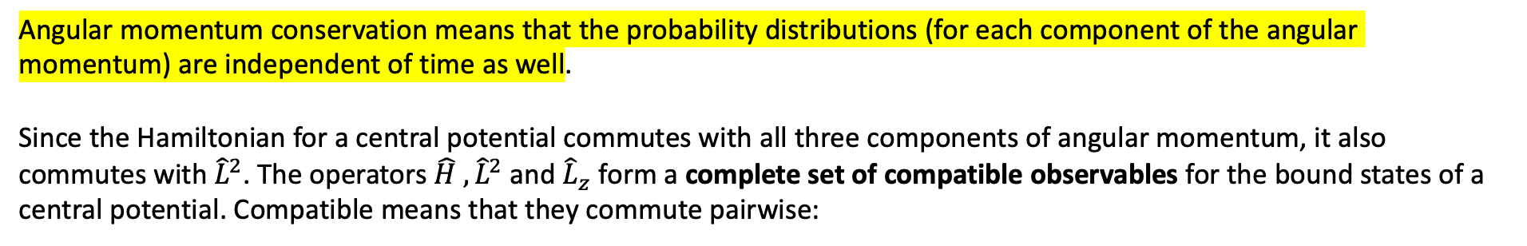
Rotationally invariant systems
Angular momentum conservation means that the probability distributions (for each component of the angular momentum) are independent of time as well.
Since the Hamiltonian for a central potential commutes with all three components of angular momentum, it also commutes with ${\hat{L}}^{2}$. The operators $\hat{H}$ ${, \hat{L}}^{2}$ and ${\hat{L}}_{z}$ form a complete set of compatible observables for the bound states of a central potential. Compatible means that they commute pairwise:
so that the eigenstates of $\hat{H}$ can be chosen to be simultaneous eigenstates of ${\hat{L}}^{2}$ and ${\hat{L}}_{z}$
Complete means that the quantum numbers n, $l$ and m (here m is the z-component of the spin angular momentum, not the mass) uniquely specify a bound state of the Hamiltonian. This is familiar from the solutions to the hydrogen atom, the infinite spherical well, and the three-dimensional harmonic oscillator, but it is true for any central potential

Slide 6
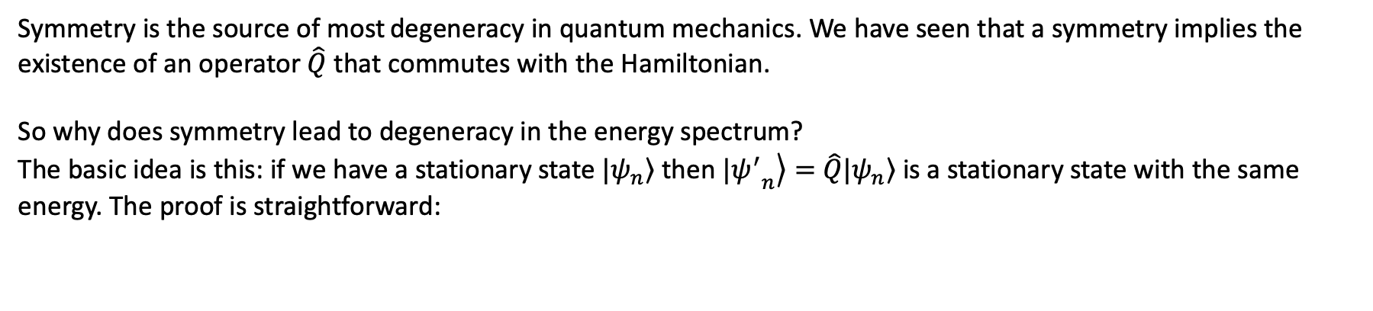
Degeneracy
Symmetry is the source of most degeneracy in quantum mechanics. We have seen that a symmetry implies the existence of an operator $\hat{Q}$ that commutes with the Hamiltonian.
So why does symmetry lead to degeneracy in the energy spectrum?
The basic idea is this: if we have a stationary state $|\left.ψ_{n}\right\rangle$ then $|\left.{ψ^{′}}_{n}\right\rangle =$ $\hat{Q}|\left.ψ_{n}\right\rangle$ is a stationary state with the same energy. The proof is straightforward:
For example, if you have an eigenstate of a spherically-symmetric Hamiltonian
and you rotate that state about some axis, you must get back another state
of the same energy.

Slide 7
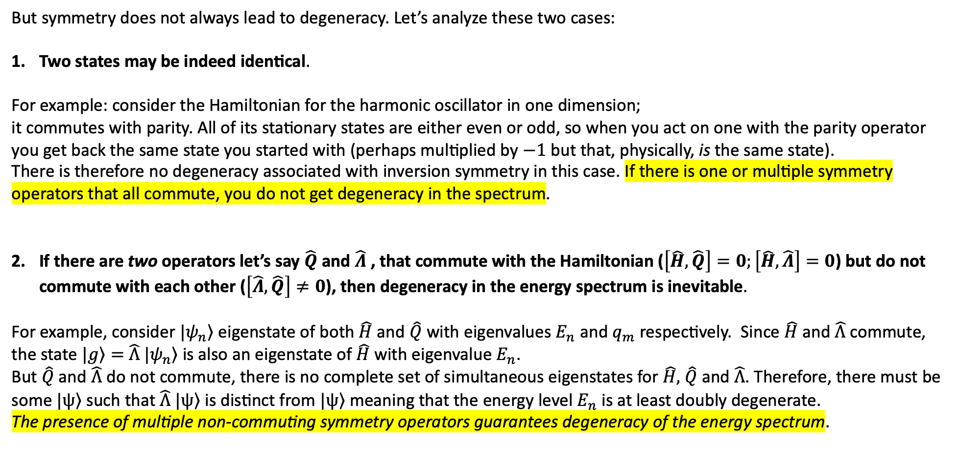
Degeneracy
But symmetry does not always lead to degeneracy. Let’s analyze these two cases:
Two states may be indeed identical.
For example: consider the Hamiltonian for the harmonic oscillator in one dimension;
it commutes with parity. All of its stationary states are either even or odd, so when you act on one with the parity operator you get back the same state you started with (perhaps multiplied by $−1$ but that, physically, is the same state).
There is therefore no degeneracy associated with inversion symmetry in this case. If there is one or multiple symmetry
operators that all commute, you do not get degeneracy in the spectrum.
If there are two operators let’s say $\hat{Q}$ and $\hat{Λ}$ , that commute with the Hamiltonian ($\left[\hat{H},\hat{Q}\right]=0;\left[\hat{H},\hat{Λ}\right]=0$) but do not commute with each other ($\left[\hat{Λ},\hat{Q}\right]≠0$), then degeneracy in the energy spectrum is inevitable.
For example, consider $|\left.ψ_{n}\right\rangle$ eigenstate of both $\hat{H}$ and $\hat{Q}$ with eigenvalues $E_{n}$ and $q_{m}$ respectively. Since $\hat{H}$ and $\hat{Λ}$ commute, the state $|\left.g\right\rangle =$ $\hat{Λ}$ $|\left.ψ_{n}\right\rangle$ is also an eigenstate of $\hat{H}$ with eigenvalue $E_{n}$.
But $\hat{Q}$ and $\hat{Λ}$ do not commute, there is no complete set of simultaneous eigenstates for $\hat{H},$ $\hat{Q}$ and $\hat{Λ}$. Therefore, there must be
some $|\left.ψ\right\rangle$ such that $\hat{Λ}$ $|\left.ψ\right\rangle$ is distinct from $|\left.ψ\right\rangle$ meaning that the energy level $E_{n}$ is at least doubly degenerate.
The presence of multiple non-commuting symmetry operators guarantees degeneracy of the energy spectrum.

Slide 8
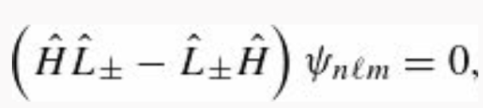
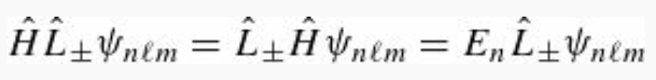
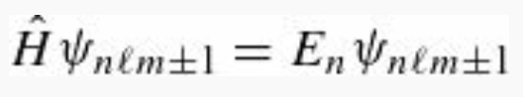
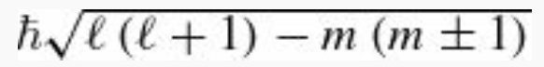
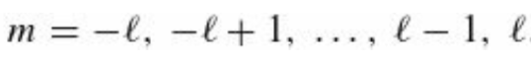
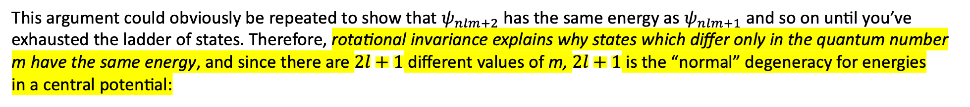
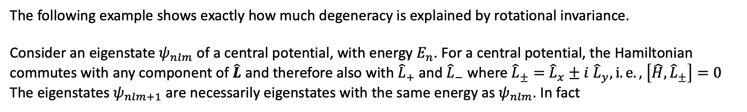
Degeneracy: example
The following example shows exactly how much degeneracy is explained by rotational invariance.
Consider an eigenstate $ψ_{nlm}$of a central potential, with energy $E_{n}$. For a central potential, the Hamiltonian commutes with any component of $\hat{L}$ and therefore also with ${\hat{L}}_{+}$ and ${\hat{L}}_{−}$ where ${\hat{L}}_{±}=$ ${\hat{L}}_{x}±i$ ${\hat{L}}_{y}, i.e.,$ $\left[\hat{H},{\hat{L}}_{±}\right]=0$
The eigenstates $ψ_{nlm+1}$ are necessarily eigenstates with the same energy as $ψ_{nlm}$. In fact
The constant is canceled on both sides
This argument could obviously be repeated to show that $ψ_{nlm+2}$ has the same energy as $ψ_{nlm+1}$ and so on until you’ve
exhausted the ladder of states. Therefore, rotational invariance explains why states which differ only in the quantum number
m have the same energy, and since there are $2l+1$ different values of m, $2l+1$ is the “normal” degeneracy for energies
in a central potential:

Slide 9
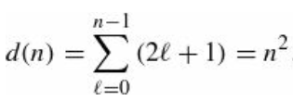
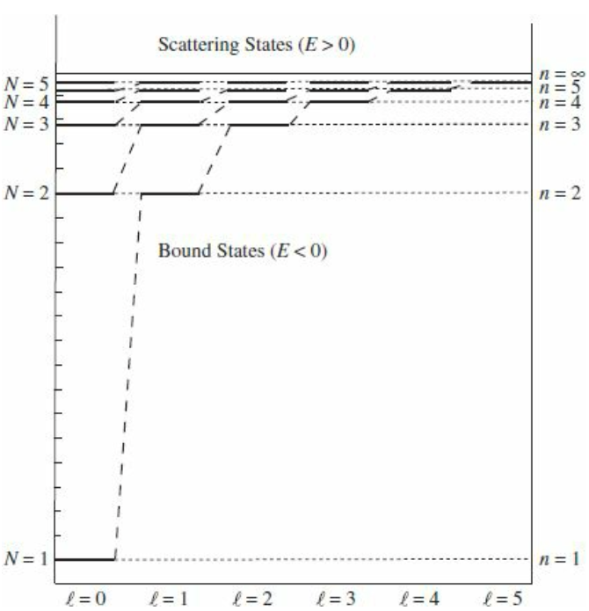
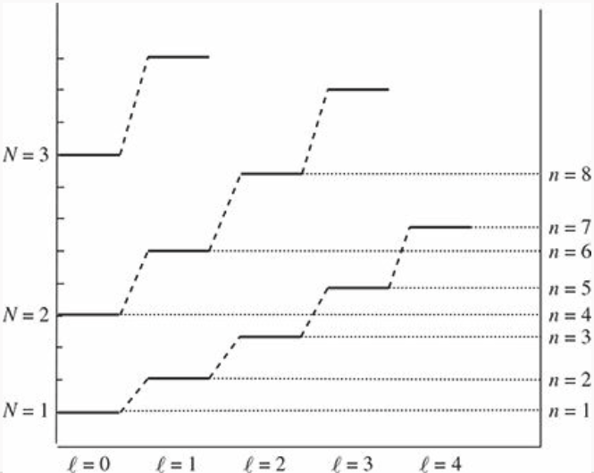
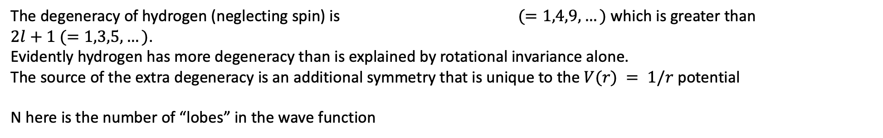
Degeneracy
The degeneracy of hydrogen (neglecting spin) is $(=1,4,9,…)$ which is greater than
$2l+1 (=1,3,5,…)$.
Evidently hydrogen has more degeneracy than is explained by rotational invariance alone.
The source of the extra degeneracy is an additional symmetry that is unique to the $V(r) = 1/r$ potential
N here is the number of “lobes” in the wave function
Energy levels for the hydrogen atom.
Note the extra (“accidental”) degeneracy of the hydrogen energies
Energy levels for the spherical well

Slide 10
Rotational Selection Rules
The most general statement of the rotational selection rules is the Wigner–Eckart Theorem; as a practical matter, it is arguably one of the most important theorems in quantum mechanics.
We’ll start developing our intuition by working out the selection rules for the two classes of operators one encounters most often: scalar operators and vector operators.
In deriving these selection rules, we consider only how the operators behave under a rotation; therefore, the results of this section apply equally well to “true” scalars and pseudoscalars, and those of the next section apply equally well to “true” vectors and pseudovectors.
These selection rules can be combined with the parity selection rules to obtain a larger set of selection rules for the operator.
After this, we’ll prove the theorem if time permits.

Slide 11
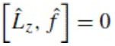
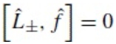
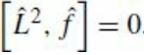
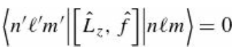
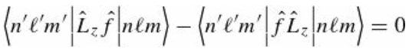
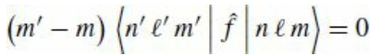
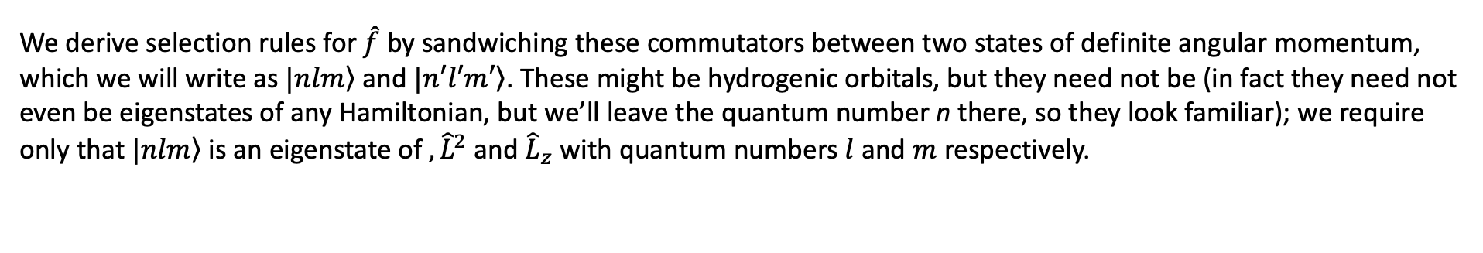
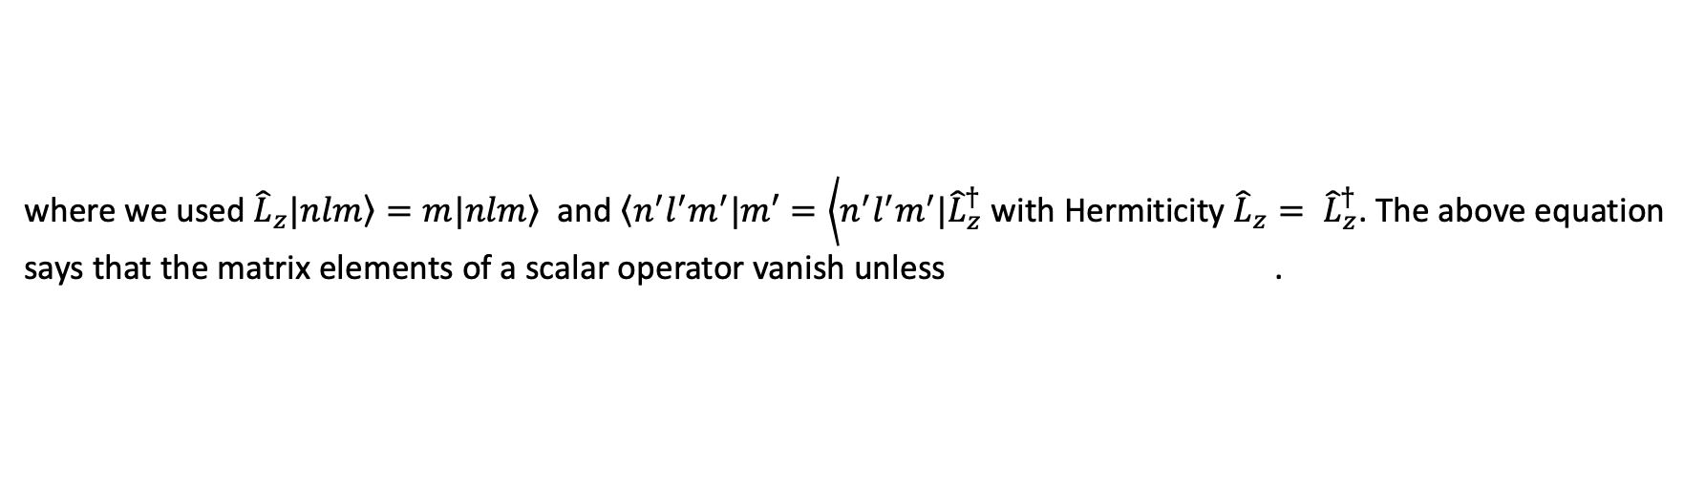
Selection Rules for Scalar Operators
The commutation relations for a scalar operator $\hat{f}$ with the three components of angular momentum can be rewritten in terms of the raising and lowering operators as
We derive selection rules for $\hat{f}$ by sandwiching these commutators between two states of definite angular momentum, which we will write as $|\left.nlm\right\rangle$ and $|\left.n′l′m′\right\rangle$. These might be hydrogenic orbitals, but they need not be (in fact they need not even be eigenstates of any Hamiltonian, but we’ll leave the quantum number n there, so they look familiar); we require only that $|\left.nlm\right\rangle$ is an eigenstate of ${, \hat{L}}^{2}$ and ${\hat{L}}_{z}$ with quantum numbers $l$ and $m$ respectively.
where we used ${\hat{L}}_{z}|\left.nlm\right\rangle =m|\left.nlm\right\rangle$ and $\left\langle n^{′}l^{′}m^{′}|m′\right.=\left\langle n^{′}l^{′}m^{′}|{\hat{L}}_{z}^{†}\right.$ with Hermiticity ${\hat{L}}_{z}= {\hat{L}}_{z}^{†}$. The above equation
says that the matrix elements of a scalar operator vanish unless .

Slide 12
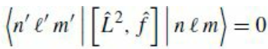
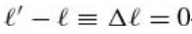
Selection Rules for Scalar Operators
Repeating the procedure for ${\hat{L}}^{2}$ we obtain the following
which tells us that the matrix elements of a scalar operator vanish unless

Slide 13
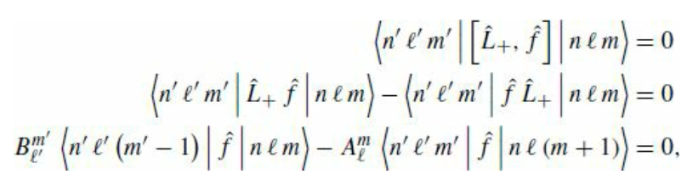
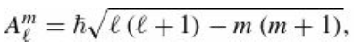
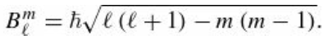
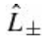
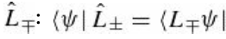
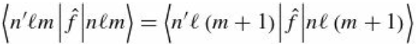
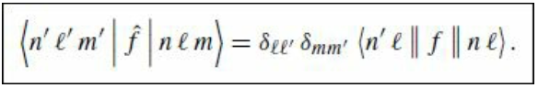
Selection Rules for Scalar Operators
We can get even more information about the matrix elements from the remaining commutators: (we’ll just do the
$``+′′$ case, the $``−′′$case is similar)
We define
We used the fact that is the Hermitian conjugate of
Both terms in the last equation above are zero unless $m’=m+1$and $l’=l$. When this conditions are satisfied then
$A_{l}^{m}=B_{l}^{m+1}$ and
Evidently the matrix elements of a scalar operator are independent of $m$.
The results of this section can be summarized as follows:

Slide 14
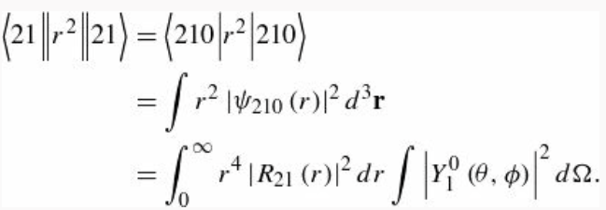
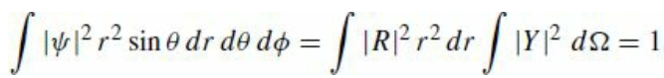
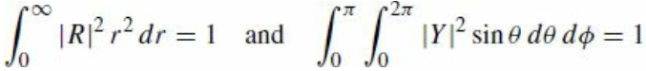
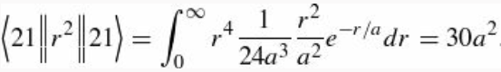
Selection Rules for Scalar Operators: Example
A. Find $\left\langle r^{2}\right\rangle$ for all four of the degenerate $n=2$ states of hydrogen atom
$n=2$ means that $l=\{0, 1$} and $m=\left\{−l,…,l\right\}→ 2l+1 =\{1, 3\}$ with a total of four states. For $l=1, m=\{−1,0,1\}$
To calculate the reduced matrix element, we simply pick any one of these expectation values:
The spherical harmonics are normalized, so the angular integral is 1, and the radial functions $R_{nl}$ are in Tab 4.7 of the book
That determines three of the expectation values.

Slide 15


Selection Rules for Scalar Operators: Example
The remaining expectation value is
Summarizing we have obtained

Slide 16





Selection Rules for Vector Operators
We now move on to the selection rules for a vector operator $\hat{V}$. This is significantly more work than the scalar case, but the result is central to understanding atomic transitions. We begin by defining, by analogy with the angular momentum raising and lowering operators, the operators

Slide 17





Selection Rules for Vector Operators
and since our states are eigenstates of ${\hat{L}}_{z}$
This equation tells us that either $m’= m ±1$ or else the matrix element of ${\hat{V}}_{±}$ must vanish. Then we have
and we can write the first set of relations
which can be translated back to the x and y components of $\hat{V}$

Slide 18







Selection Rules for Vector Operators
The remaining selection rules give us
Where $C_{m_{1}m_{2}M}^{j_{1}j_{2} J}$ are the Clebsch–Gordan coefficients that appear in the addition of angular momenta (see Sec 4.4.3 of the book for a recap).
The Clebsch–Gordan coefficient vanish unless ${m=m}_{1}+m_{2}$ (since the z-components of angular momentum add), and unless $J=$ $j_{1}{+j}_{2},j_{1}{+j}_{2}−1,…| j_{1}{−j}_{2}|$. In particular,
$$≠0 if$$

Slide 19





Example: Selection Rules for $\hat{r}$
Find all matrix elements of $\hat{r}$ between the states with $n=2, l=1$and$n’=3, l’=2$. That is
where $m=−1,0,1$and $m’=−2,−1,0,1,2$and $r_{i}=x,y,z$. Essentially, we have and
We start by calculating one of the matrix elements

Slide 20




Selection Rules for Vector Operators
and from the equations we have seen before
we can then determine the reduced matrix element
With the remaining relations, using the Clebsch-Gordan coefficients
we can calculate all the other matrix elements. See example 6.5 in the book for more details.

Slide 21



Translations in Time
It’s time to study time-translation invariance (no pun intended). Consider a solution $Ψ(x,t)$ to the TDSE
We can define the operator that propagates the wave function forward in time $\hat{U}(t)$
$\hat{U}(t)$ can be expressed in terms of the Hamiltonian, and doing so is straightforward if the Hamiltonian is not itself a function of time. In that case, expanding the right-hand side
*Here we are assuming that the solution of the TDSE can be Taylor expanded. This is not always the case.

Slide 22




Translations in Time
Therefore, in the case of a time-independent Hamiltonian, the time-evolution operator is
We say that the Hamiltonian is the generator of translations in time. Note that $\hat{U}(t)$ is unitary.
The time-evolution operator offers a compact way to state the procedure for solving the time-dependent Schrödinger equation. To see the correspondence, write out the wave function at time $t=0$ as a superposition of stationary states
And then we evolve with $\hat{U}(t)$
Here we are expanding the initial wave function in terms of stationary states and then tacking on the “wiggle factors”
to obtain the wave function at a later time.

Slide 23






The Heisenberg Picture
We can examine the effect of applying time-translation to operators, as well as to wave functions. The transformed operators are called Heisenberg-picture operators, and we follow the convention of giving them a subscript H rather than a prime
EXAMPLE 1. A particle of mass m moves in one dimension in a potential $V(x)$. We want to find the position operator in the Heisenberg picture for an infinitesimal time translation $δ$. SOLUTION:
Therefore, we can write
Wow! This looks exactly like classical mechanics

